Slide 1
Hindi 3CA Feelings
Keshav Sota

Slide 2
Pop Quiz!
We shall review important concepts from last class.
What’s new?
Did you like it?
I’m lost.
Can you help me?
I’m looking for John.

Slide 3
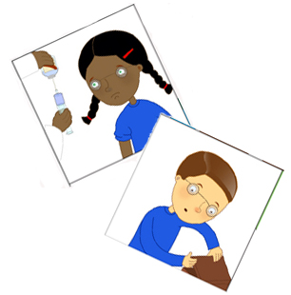
Formula for speaking feelings in Hindi
Mai ____ hoon. ( I am )
Generally works for all cases
Vo_____ hain( He/She is)
Hum______ hain ( We are)

Slide 4
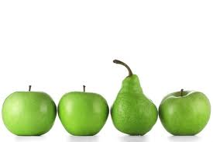
Formula for exception actions/feelings
Main____ gayaa hu. ( I am now…)
Usually used for verbs. Idiomatic phrases. CAN BE CONVERTED TO STANDARD FORMULA
Mujhe____ hai ( I have…)

Slide 5
Feelings Standard
Main khush hoon – I am happy
Main naraaz hoon- I am furious
Main hairan hoon- I am shocked
Main pareshan hoon- I am nervous
Main vyasth hoon- I am busy
Main chinthith hoon- I am worried.
Main shaanth hoon- I am calm
Main has raha hoon – I am laughing
Mai muskura (raha) hoon- I am smiling

Slide 6
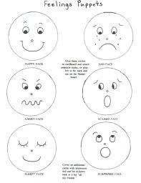
Feelings Standard Cont..
Main theek hoon – I am fine
Main jaldhi ( mai) hoon- I am in a hurry.
Mai sharminda hoon- I am embarrassed.
Mai dukhee hoon- I am sad.

Slide 7

Exception cases
Mujhe pyar ho gaya hai- I am in love
Mai thak gaya hoon- I am tired
Mai dar gaya hoon- I am scared
Mujhe neend aarai hai- I am sleepy
Mujhe thand lag rahi hai- I am cold
Mujhe garmi lag rahi hai- I am hot
Mujhe bhuuk lag rahi hai- I am hot.
Mujhe pyas lag rahi hai – I am thirsty.

